Slide 1

CPU Scheduling Algorithms
Team Members:
Bahaa Mahmoud Helmy → 21-00550
Abdalla shreif Mohammed → 21-00242
Selvana Atef Kadry → 21-01588
Reham Ahmed Thabet → 21-01496

Slide 2
Introduction to CPU Scheduling
What is CPU Scheduling?
Project Objective
CPU scheduling is a crucial aspect of operating systems. It determines which process runs on the CPU at any given time, ensuring efficient utilization of system resources.
Develop a simulation tool to visualize and analyze CPU scheduling algorithms. Our goal is to help users understand the performance impact of each algorithm, providing a hands-on learning experience for complex operating system concepts.
Our project covers four key algorithms:
First Come First Serve (FCFS)
Shortest Job First (SJF)
Round Robin (RR)
Priority Scheduling

Slide 3
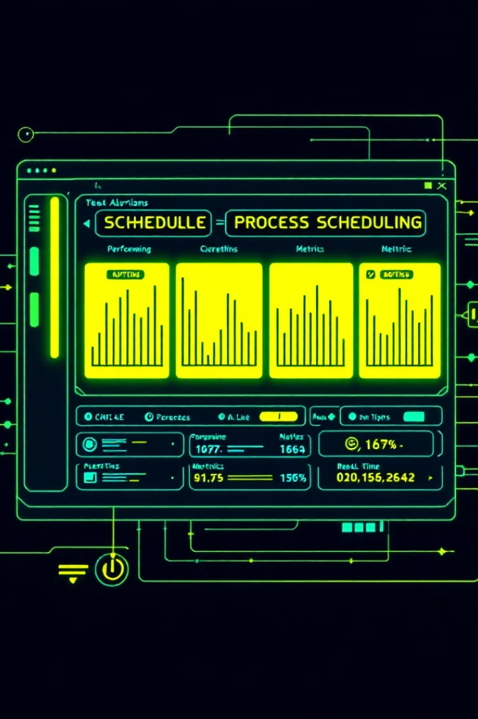
Features of the Tool
GUI-based Input and Interaction
Support for Multiple Algorithms
User-friendly interface for easy operation and visualization
First Come First Serve (FCFS), Shortest Job First (SJF), Round Robin (RR), Priority Scheduling
Performance Metrics Calculation
Real-time Process Management
Add processes and configure parameters (e.g., quantum time, priority) on the fly
Average Waiting Time and Average Turnaround Time

Slide 4

Implementation Overview
Development Environment
System Flow
Input Section: Burst Time, Process Number, Priority, Quantum Time
Programming Language: Java
GUI Framework: Swing
Algorithm Selection: Radio buttons for FCFS, SJF, Round Robin, and Priority Scheduling
Tools: NetBeans/IntelliJ IDEA, JDK
Output Display: Average Waiting Time, Average Turnaround Time

Slide 5
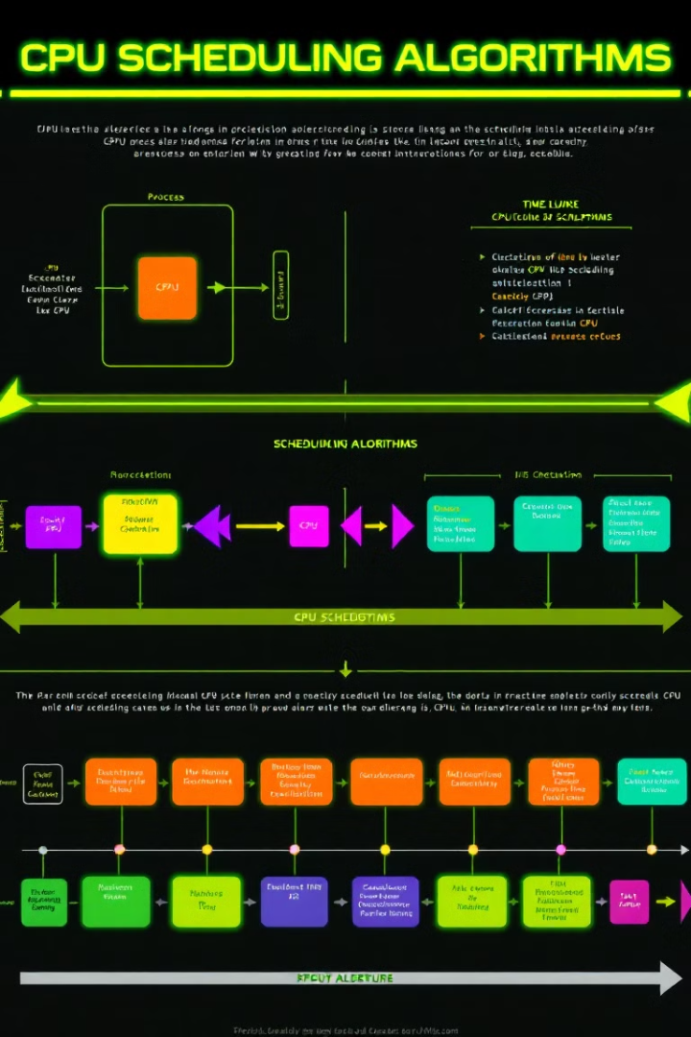
Explanation of Algorithms
1
First Come First Serve (FCFS)
Description: Executes processes in the order they arrive. Non-preemptive.
Code Flow: Calculate waiting and turnaround times sequentially.
Formula: WT[i] = WT[i-1] + BT[i-1]
2
Shortest Job First (SJF)
Description: Processes with the shortest burst time are executed first. Non-preemptive.
Code Flow: Sort processes by burst time. Calculate waiting and turnaround times after sorting.
3
Round Robin (RR)
Description: Assigns a quantum time for each process. Preemptive scheduling; processes execute cyclically.
Code Flow: Iteratively reduce burst time by quantum time until completion.
4
Priority Scheduling
Description: Processes are executed based on priority levels. Non-preemptive (in this implementation).
Code Flow: Sort processes by priority. Calculate waiting and turnaround times after sorting.

Slide 6



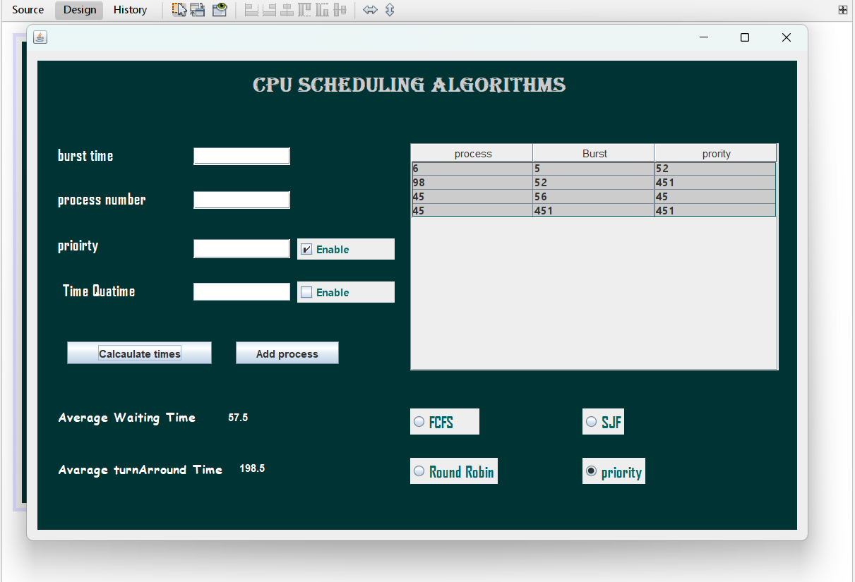


Tool Demonstration
Step 1: Add Processes
Add processes with burst time and process numbers. Enable optional parameters (priority or quantum time).
Step 2: Select Algorithm
Choose a scheduling algorithm from the available options.
Step 3: Calculate
Calculate average waiting and turnaround times.
Step 4: View Results
View results in the output section.

Slide 7
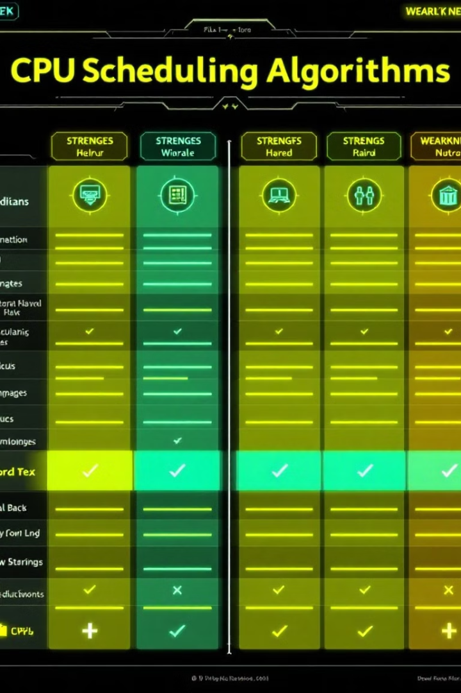
Performance Comparison
Algorithm
Preemptive
Sorting Required
Key Parameters
FCFS
No
No
Arrival Time
SJF
No
Yes
Burst Time
Round Robin
Yes
No
Quantum Time
Priority
No
Yes
Priority Level
Strengths and Weaknesses
Each algorithm has its own strengths and potential pitfalls, which are important to consider when selecting the appropriate scheduling technique for a given system.

Slide 8
Challenges and Solutions
Challenges
Solutions
Handling edge cases like empty inputs and incorrect configurations.
Input validation and error handling using JOptionPane.
Optimization of sorting and iteration logic.
Efficiently implementing Round Robin logic for large datasets.

Slide 9

Conclusion
Project Recap
Importance
Successfully implemented a simulation tool for visualizing CPU scheduling algorithms.
Highlighted the importance of selecting appropriate scheduling techniques based on system needs.
Educational Significance
The tool provides an interactive way to understand CPU scheduling concepts.

Slide 10




Future Enhancements
Preemptive Algorithms
Gantt Chart Visualization
Add support for Preemptive SJF and Preemptive Priority Scheduling.
Include Gantt chart visualization for better process tracking.
Performance Graphs
Provide performance graphs comparing algorithms under various workloads.

Slide 11
Thanks Any Questions..?

